Slide 1
Computer Architecture Concepts
Part 13 – Registers and memory

Slide 2
Objectives
To describe the concept of a register and consider how one could be constructed from flip-flops
Describe addressable memory and see how it could be constructed from registers

Slide 3
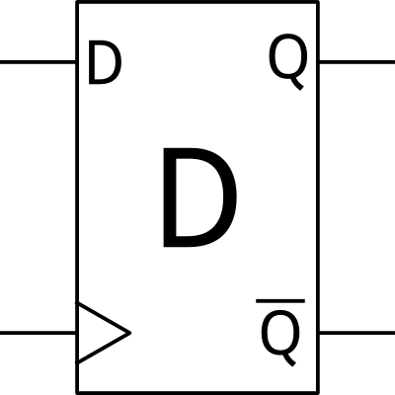
Flip-flop
A flip-flop can store and output one bit of data
Changes to the flip-flop happen on the rising-edge of the clock signal
The clock signal is input at the point that has the triangle symbol

Slide 4
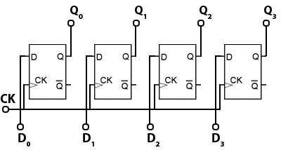
Register
We can group flip-flops together to store more bits
This storage is called a register
Note that they all have the same clock signal so the storage is synchronised
A CPU contains registers

Slide 5
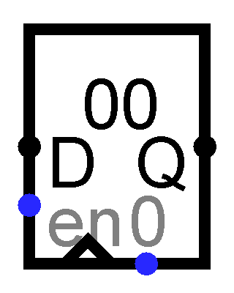
Register in Logisim
The register has several inputs
D for data to store
Q for output
Clock
Enable – the value stored will only change when the clock changes to 1 and the Enable signal is 1
Zero – to set the register back to storing zero
This register stores 8 bits – so is shown as storing two hex digits (00)

Slide 6
Memory
A register is a collection of bits
We need to consider how we could use many registers in a system
We assign each register a number
This number is the address
Addresses generally start at 0 and go up in ones
We need to make sure that only the one we want is updated
We can feed the address signal to a decoder and connect the decoder’s outputs to the enable inputs of the registers so that only one register has enable set to 1
We need to be able to read the output from a specific register
We can use a multiplexer (selector) to select the required register according to an address signal

Slide 7
Summary
We have seen how flip-flops can be connected together to form a register
We have considered how we might use many registers together with an address to specify which one to use to form addressable memory

